Slide 1
Supplier Diversity Program
Coffee Connection and Supplier Fair
June 1, 2017

Slide 2
Welcome and Recognitions
l
Dr. Jason Rogers
Vice-President for Administration
and University Counsel

Slide 3
Why Supplier Diversity is Important to Nashville
Jerval Watson
Business Development Officer
Metro Nashville
Office of Minority and Women Business Assistance

Slide 4
Why Diversity Matters at Belmont
Belmont University is a student-centered Christian community providing an academically challenging education that empowers men and women of diverse backgrounds to engage and transform the world with disciplined intelligence, compassion, courage and faith.

Slide 5
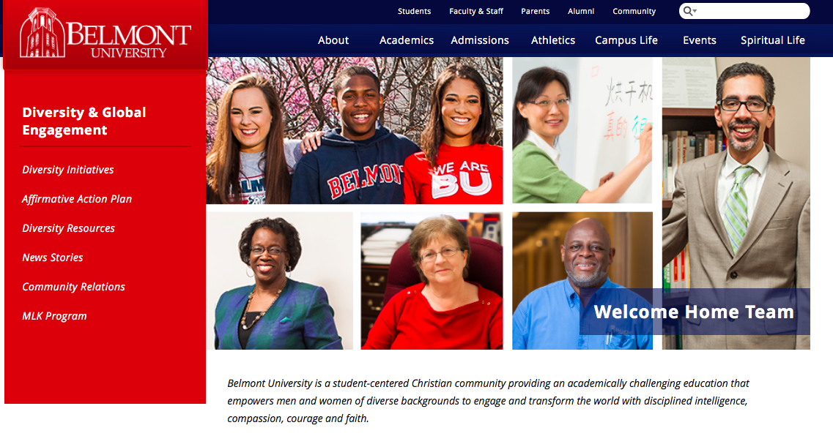
The Welcome Home Team
Explores initiatives and plans strategies to create a culture of inclusion. Through the efforts of this group, Belmont will strive to become a model for creating and sustaining a culture of racial and ethnic diversity while producing a welcome environment for all.
Notes:
We invite you go to the Welcome Home page on the Belmont website to see more.

Slide 6
Student Diversity
 | All Students | Minority Students
2010 | 5,888 | 831
2016 | 7,723 | 1,676

Slide 7
University Staff Diversity
 | All Staff | Minority Staff
2010 | 479 | 82
2016 | 548 | 142

Slide 8
Faculty Diversity
 | All Faculty | Minority Faculty
2010 | 301 | 20
2016 | 390 | 43

Slide 9
Progress of the Supplier Diversity Program
OUR GOAL
Diversify Belmont’s contractor/supplier base to become reflective of our
local and global community while maintaining a high standard of quality in
all products and services we provide
Phase 1 FY 2015-2016
Phase 2 FY 2016-2017
Phase 3 FY 2017-2018
Collected feedback from 2016-17 suppliers and Budget Managers
Expanded SDP to all departments
Identified Departments’ Needs
Met with Partners
Connected minority businesses with FMS and AUX
Awarded contracts
Monitored and collected feedback
Established SDP team
Formed Partnerships
Identified needs for
Facilities Management Services and
Auxiliary Enterprises
Researched minority businesses to meet needs

Slide 10
Supplier Diversity Program Partners
Metro Nashville Airport Authority Nashville Minority Business Center
Metro Nashville Business Assistance Office Sagents Partners, LLC
Nashville Hispanic Chamber TN District Office U.S. Small Business Administration
Nashville Black Chamber TN Latin Chamber Tri-State Minority Supplier Development Council
Notes:
.

Slide 11
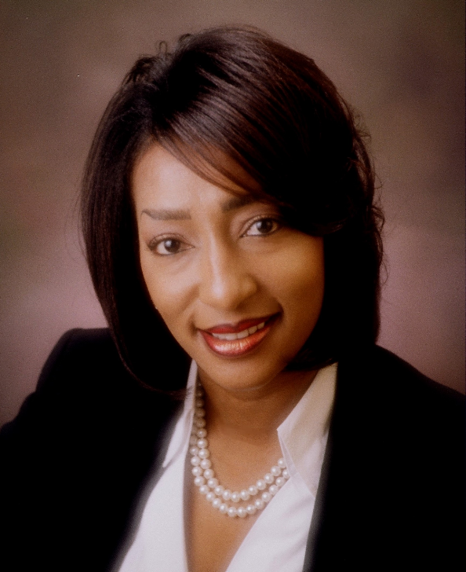
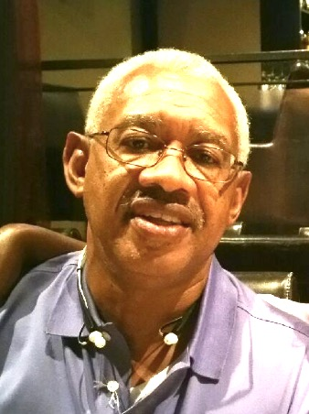
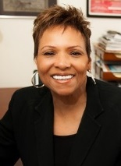
Experiences of Belmont Suppliers: A Conversation
Karen Isabel
Dalmation Creative Agency
Richard Friley
InShuttle Transportation, Inc.
Joyce Searcy
Director
Office of Community Relations

Slide 12
Tips for Doing Business with Belmont
Do your homework
a. Search the Belmont web site – get to know us.
b. Review the Bruin Guide for general conduct requirements.
http://issuu.com/office.communications/docs/2015-bruin-guide-final
c. Learn the Belmont culture. We expect a quality product, on time and on budget.
d. Recognize direct solicitations on campus (to students, staff, faculty) are strictly prohibited.
e. Call ahead to schedule appointments – announce you are working through the SDP.
Leave samples or do demos of your services.
Build relationships based on trust.
Respect all campus rules about smoking, security, safety, parking etc.
Park only in authorized areas – visitor parking in all garages.
Think about students first. They are our top priority.
Respect Belmont’s chain of command. If you get a “no” at a lower level, continue to provide additional
information to get to a “yes.” Do not elevate your request.
Understand Belmont’s purchasing commitment authority.
Get a purchase order number before you start work.
Invoice promptly to be paid promptly.
Supervise your subcontractors and employees. Belmont managers will not supervise your crew.
Once you have a business relationship, remember that it is a two-way street. Belmont may seek your
support for charitable causes.

Slide 13
SDP - Next Steps
Connect Suppliers with Belmont purchasers.
Post 2017-18 opportunities for suppliers and contractors on the website.
Develop a list of qualified minority and women-owned businesses who meet needs on our finance page for purchasers and determine gaps
Plan and implement a training program for Belmont employees.
Monitor our program.
Continue to work with our SDP partners to improve our program and growing the number and quality of minority and women-owned businesses in Nashville.

Slide 14
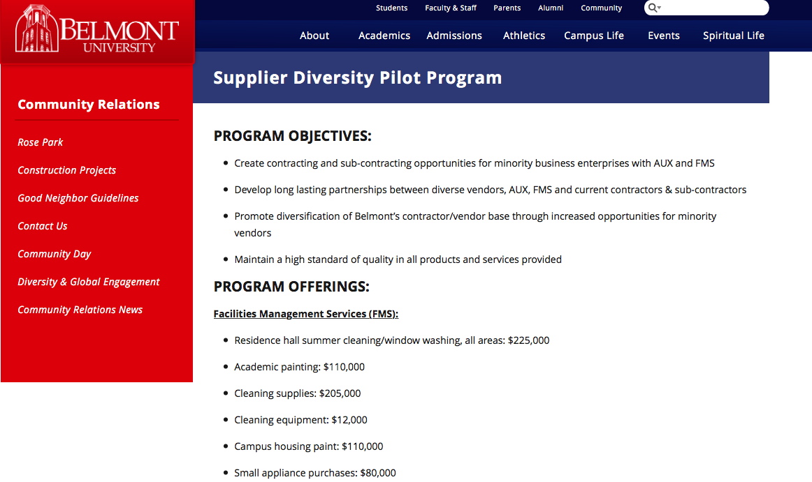
The Supplier Diversity Webpage

Slide 15
Q&A
Notes:
In your packets, you will see a map of the space where you will be connecting. This will be a little like speed dating, but we want to keep it very flexible. Some suppliers asked for tables, and those suppliers have been listed with their table numbers on the back of the map. We would like for Belmont purchasers to meet them at the tables if your department is in need of what they offer.
For general business categories, you will see a map where you can congregate. A Belmont employee has been assigned to each of these areas to keep traffic flowing. Please also feel free to also meet in the area where coffee and refreshments are. If you find that you might want to connect, please exchange contact information or arrange to exchange any other specific information that will help.
Finally, we just want to thank all of you for attending today, and for helping to make our Supplier Diversity Program a success – for Belmont and for Nashville.

